Slide 1
Blood Visual Abstracts
Spotlight Visual Abstract Template
Notes:
Slide #1. Title

Slide 2
User Guide
This PowerPoint file has been conceived to help Blood Authors prepare their visual abstracts regarding Blood Spotlights.
Blood Spotlights are articles that focus on emerging scientific and clinical developments or a recent burst of advances on a particular theme in a circumscript area.
Slide #3 reports a Template for creating a visual abstract:
Top panel: Non-assertive, Capitalized Title That Defines the Topic for the Average Reader That the Journal Is Trying to Reach (and is not an expert in your field);
The central field should summarize the Main Points of your Spotlight: Please limit the text as much as possible and use clear illustrations;
Bottom panel: Conclusions (1 or 2 Key Points) with DOI (this latter will be added by Blood staff during production).
Please consider that a Spotlight Visual Abstract may be prepared also using a 2-Point or 3-Point Visual Abstract Template.
Your Visual Abstract will be peer-reviewed, and you might be invited to modify/improve it before publication online.
Final edits/adjustments will be made inhouse during production.
Notes:
Slide #2. User Guide

Slide 3
Notes:
Slide #3. Spotlight Visual Abstract Template

Slide 4
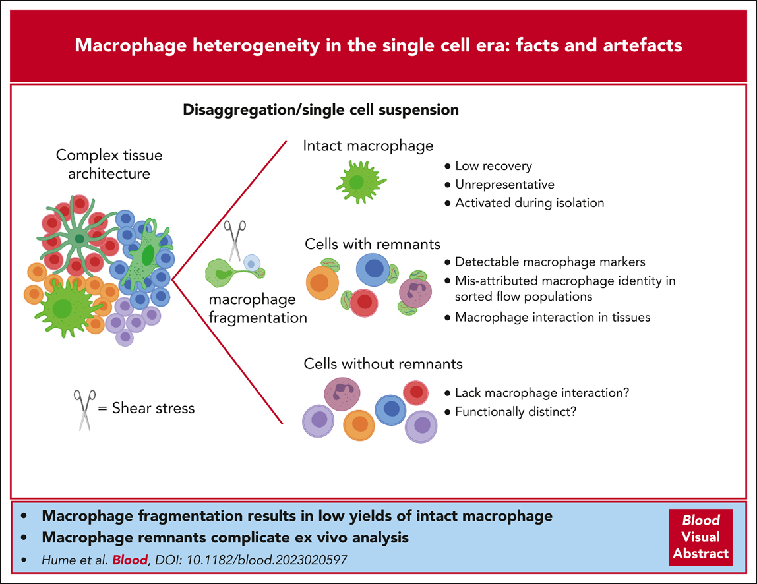
Macrophage heterogeneity in the single-cell era: facts and artifacts
David A. Hume,Susan M. Millard,Allison R. Pettit, Macrophage heterogeneity in the single-cell era: facts and artifacts, Blood, 2023,
Copyright © 2023 American Society of Hematology
Notes:
Blood Spotylight Article

